Slide 1
PRESENTATION ON
RESTAURANT MANAGEMENT
SYSTEM
Presented By :-
VISHAL SRIVASTAVA

Slide 2
RESTAURANT MANAGEMENT SYSTEM
Purpose –
The restaurant management software is capable of storing all the data that relates to the employees. It stores the employee’s payslips, leave reports and all other information relating to them which eliminates too much paperwork. The system is also capable of handling the work schedules, shift reports which assist in ensuring communication and scheduling are in order.
Scope –
The scope of restaurant management system is the online system including the management of finances, management
of employee scheduling, and the customer online ordering system. The scope does not include the internal operations of
the restaurant.
Definition-
Menu Maintenance-
Online Menu access
The customers shall be given access to the menus for restaurant online.
Page Number on the menu
The menu must all have pages numbered in the lower right hand corner.

Slide 3
2. Accounts-
Accounting
The section describes business rules that apply to handling of accounts payable, accounts receivable, payroll, taxes,
utilities, and other expenses.
Maintain Accounts Payable
The accounts payable shall be broken out and grouped into sections by vendor.
Maintain Accounts Receivable
The accounts receivables shall be maintained and grouped nightly, weekly, monthly, and yearly.
Online Ordering-
This section describes business rules that apply when customers place an online order.
Local phone number
All online orders must supply a local telephone number to facilitate confirmation of the order.
Order time frame
Orders may be placed no more than five days in advance.
Abbreviation-
RMS – Restaurant management system.
POS-Point Of Scale.
References-
Wikipedia.
Rasoi restaurant.
Capterra.

Slide 4
Overview-
The Zaika Restaurant Management System (RMS) represents the most comprehensive restaurant point of sale (POS) tool in our arsenal.
Our solution is not only focused on your in-store operations, but strategic cost reduction, revenue channel growth
and process optimization.
ER Diagram-
An entity–relationship model (ER model for short) describes interrelated things of interest in a specific domain of knowledge. A basic ER model is composed of entity types (which classify the things of interest) and specifies relationships that can exist between instances of those entity types.
In software engineering, an ER model is commonly formed to represent things that a business needs to remember in order to perform business processes. Consequently, the ER model becomes an abstract data model, that defines a data or information structure which can be implemented in a database, typically a relational database.

Slide 5
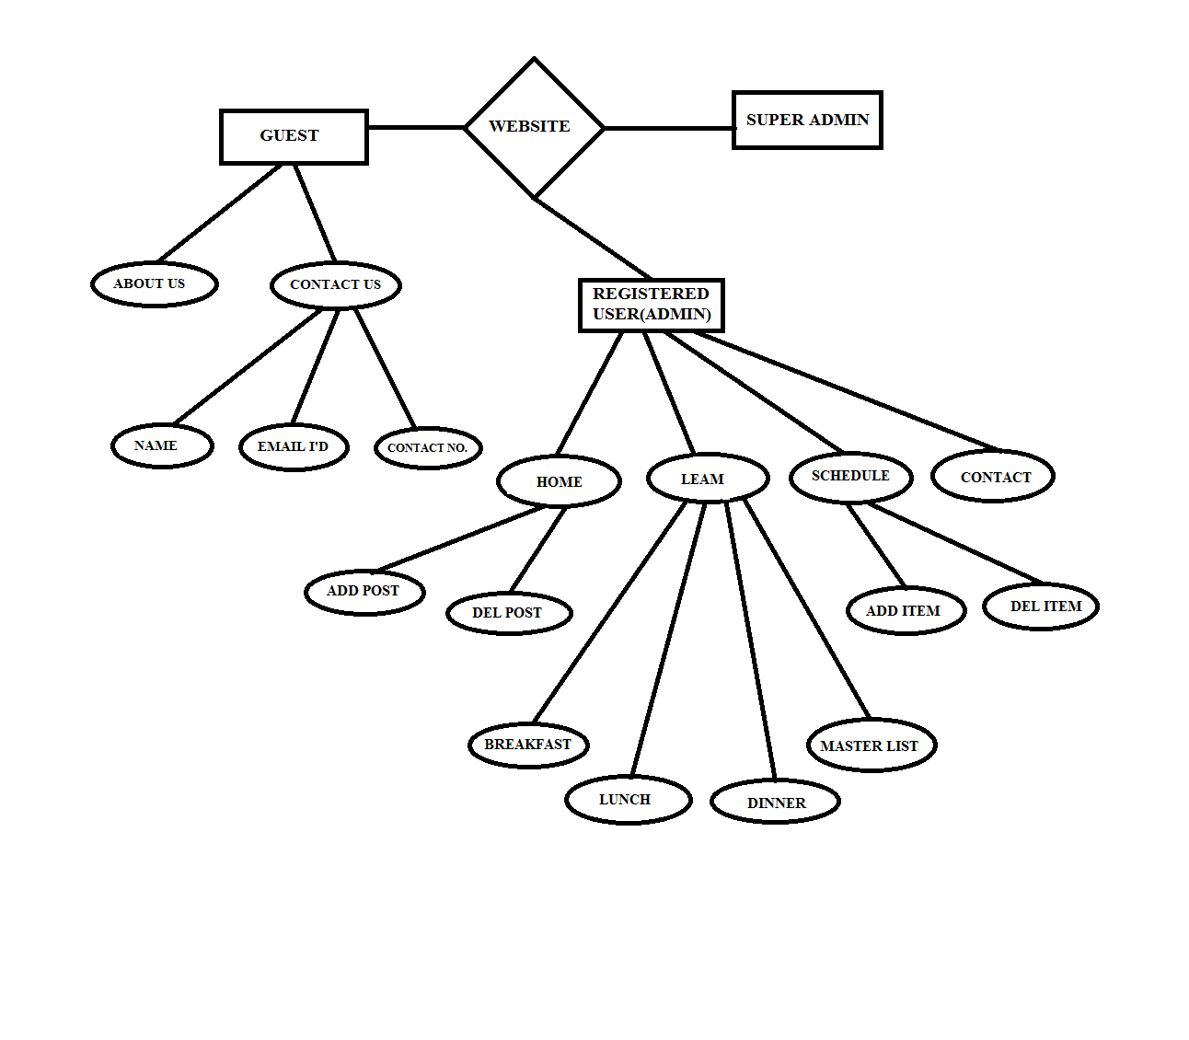

Slide 6
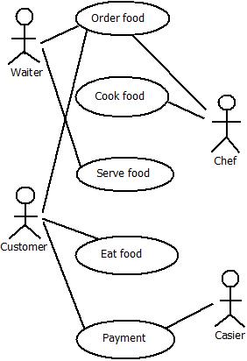
Use Case-
A use case diagram at its simplest is a representation of a user's interaction with the system
that shows the relationship between the user and the different use cases in which the user is
involved.

Slide 7
DATA FLOW DIAGRAM (DFD)
A data flow diagram (DFD) is a graphical representation of the "flow" of data through an information system, modelling its process aspects. A DFD is often used as a preliminary step to create an overview of the system without going into great detail, which can later be elaborated.DFDs can also be used for the visualization of data processing(structured design)

Slide 8
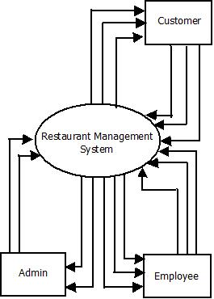
O LEVEL DFD

Slide 9
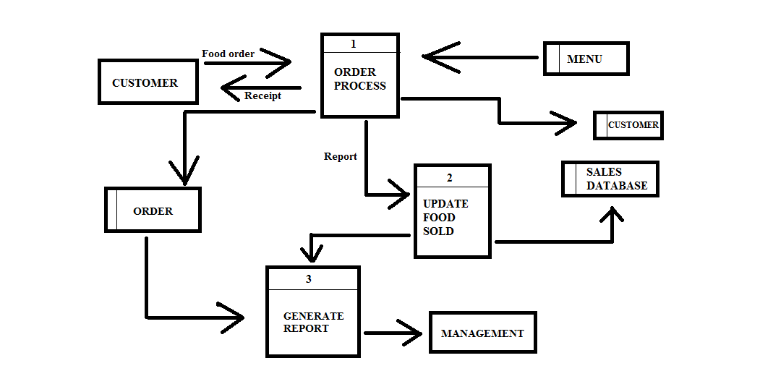
1 LEVEL DFD

Slide 10
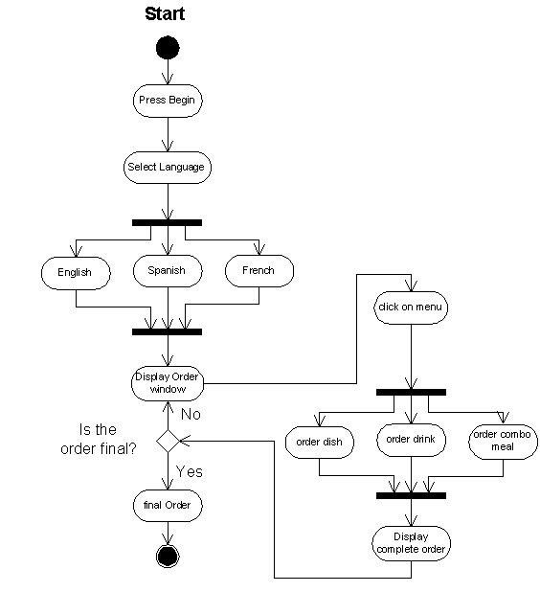
Activity Diagram-

Slide 11
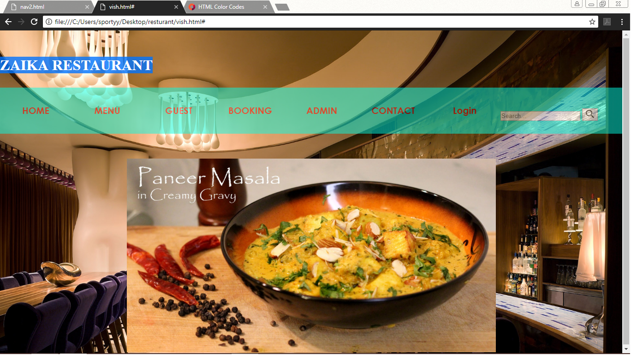
User Interface -

Slide 12
Hardware Requirement -
Hardware requirement are as follow:-
Processor : Dual-Core CPU.
Installed Memory (RAM): At least 350 MB.
System Type: 32 bit operating system.
Model: Presario CQ57.
Resolution: 1366/76

